Slide 1

Inside Sales Mastery Series
Salesforce Reporting and Dashboard – Part 2
Session# 4
Hosted by: Feedback & Analytics Team (Marketing Operations)
18 December 2024

Slide 2
Welcome to Inside Sales Mastery Series
About this Series
This training series is designed specifically for our inside sales team to enhance your skills in several key areas.
Gain expertise in essential tools and techniques.
Learn best practices to streamline your workflow.
Ensure everyone is on the same page with the latest industry standards and practices.
Ask a question – Pre-submit your questions here or ask during the office hours
Learn how to leverage IQVIA’s marketing systems and processes most effectively
Action: Sign up here, if you need to be added to the outlook invite
Reminder: Save your questions for the end or enter in the chat. We will address as many as we can!

Slide 3
Table of Contents
Introduction
Benefits
Dashboard Creation
Filters
Resources

Slide 4
Introduction
Salesforce dashboards are powerful tools that visualize key data from one or multiple Salesforce reports.
Data visualization make complex information accessible and actionable, enabling better decision-making.
Dashboards allow users to compare different metrics year over year, providing insights into trends and performance changes over time.
Dashboards update instantly, ensuring access to the most current data. Real-time metrics help in making timely decisions based on the latest information.
Salesforce dashboards can be downloaded as PNG images, allowing users to easily share visual insights with stakeholders or include them in presentations.

Slide 5
Benefits
Individual Salesperson Performance Helps identify top performers and areas for improvement among sales staff. Track metrics such as sales volume, deal closure rate, and customer satisfaction scores.
Pipeline Performance Offers visibility into the progress and potential of sales opportunities. Monitor the number of deals in each stage of the sales funnel.
Forecasts Enables more accurate revenue predictions and resource planning. Use historical data and current pipeline status to project future sales.
Product Performance Understands which products are driving sales and which need attention. Analyze sales data by product line to identify trends and market demand.
Open and Closed Opportunities Tracks the status and outcome of sales efforts. Compare open opportunities with closed deals to evaluate sales cycle efficiency.
These insights can guide strategic decisions, optimize sales processes, and drive better performance across the board

Slide 6
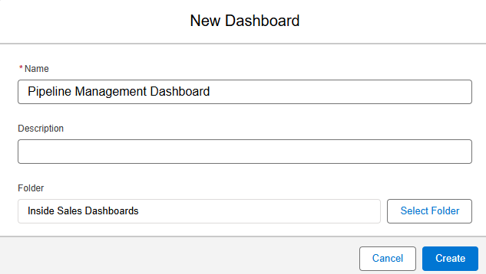
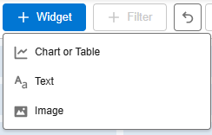
Dashboard Creation
Go into Reports tab and create the source reports for the dashboard (The reports should have at least one type of grouping for visualization)
Go to the Dashboards tab
Click on New Dashboard, name the dashboard and choose the appropriate folder and click Create
Click on the + Widget icon on the top right-hand corner and select the Chart or Table

Slide 7

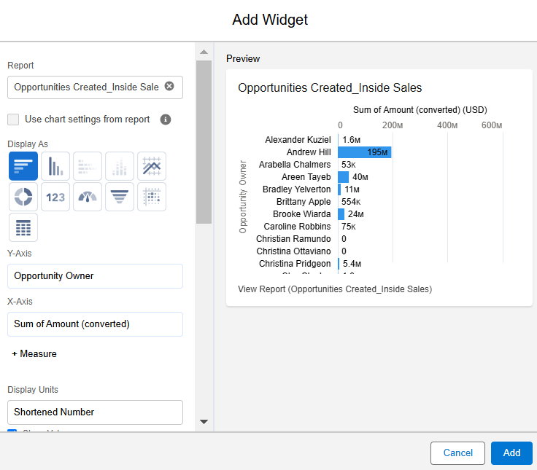
Choose the report to be added to the dashboard and click Select
System creates the axes based on the report grouping
You can add a Title, Footer or change the Axes, Visualization, Display and sort etc., in the Add Widget
Once the Widget is ready, click on Add (A dashboard can have a maximum of 20 Widgets)
Click Save

Slide 8
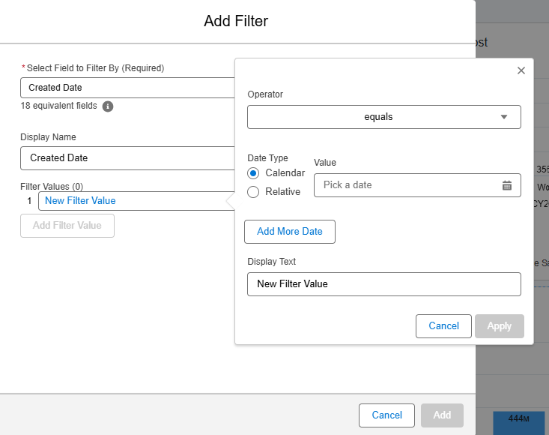
Filters
Customize the data displayed, focusing on specific time periods, regions, or other criteria.
Click on the Dashboard where you need to add the filter
In the top-right corner, select Edit and then click on + Filter
Choose the Field you’d like to filter by
Add a Display Name to the new filter to easily identify it later
Click New Filter Value Choose an Operator (e.g., equals, contains, greater than). Enter/select the desired value(s). If you need multiple values, separate them with a comma.
Select Apply to activate the filter.
When you're done editing, select Save and then Done
Important Notes:
Each dashboard can have up to 5 filters.
Each filter can have up to 50 Dashboard Filter Options.

Slide 9
Reports and Dashboards at the Year-End
Reports (2024)
Dashboards (2024)
Lead Conversion Report:
Lead Conversion Rate: Shows the percentage of leads converted to opportunities.
Conversion by Lead Source: Identifies which sources are most effective.
Average Time to Convert: Measures the average time taken to convert leads
Pipeline Management Report:
Pipeline by Stage: Visualizes the number of opportunities at each stage.
Pipeline Value: Displays the total potential value of the pipeline.
Win/Loss Analysis: Compares won vs. lost opportunities to identify trends
Lead Engagement Report:
Lead Activity: Tracks interactions with leads (calls, emails, meetings).
Lead Response Time: Measures the average time taken to respond to new leads.
Engagement Score: Aggregates engagement metrics to score leads
Lead Conversion Dashboard:
Conversion Funnel: Visual representation of lead conversion stages.
Top Performing Lead Sources: Highlights sources with the highest conversion rates.
Conversion Rate Over Time: Tracks conversion rate trends over the year
Pipeline Management Dashboard:
Pipeline Health: Overview of the pipeline's current state.
Stage Distribution: Breakdown of opportunities by stage.
Forecast vs. Actuals: Compares forecasted revenue to actual closed deals
Lead Engagement Dashboard:
Activity Heatmap: Visualizes peak times for lead engagement.
Response Time Metrics: Shows average response times and trends.
Engagement Leaderboard: Ranks team members based on engagement activities

Slide 10
Resources
The Trailheads in the Salesforce Help section can help with custom reports and dashboards.
Reports & Dashboards for Lightning Experience
Create Reports and Dashboards for Sales and Marketing Managers

Slide 11
Open Q&A/Discussion

Slide 12
Thank You!

